Slide 1

CSE- 321
Software Engineering
Lecture : 04 Software Processes
Fahad Ahmed
Lecturer, Dept. of CSE
E-mail: fahadahmed@uap-bd.edu

Slide 2
Lecture Outlines
Software Development Lifecycle
Software Processes
Software Requirement Specification
Software Process Model

Slide 3
Software Development Life Cycle
What is SDLC?
SDLC stands for Software Development Lifecycle. SDLC is a systematic process for building software that ensures the quality and correctness of the software built. SDLC process aims to produce high-quality software that meets customer expectations.
Why SDLC?
It offers a basis for project planning, scheduling, and estimating
Provides a framework for a standard set of activities and deliverables
It is a mechanism for project tracking and control
Increases visibility of project planning to all involved stakeholders of the development process
Increased and enhance development speed
Improved client relations
Helps you to decrease project risk and project management plan overhead

Slide 4
Software Development Life Cycle
SDLC Phases
The entire SDLC process divided into the following stages:
Phase 1: Requirement collection and analysis
Phase 2: Feasibility study
Phase 3: Design
Phase 4: Coding
Phase 5: Testing
Phase 6: Installation/Deployment
Phase 7: Maintenance

Slide 5
Software Development Life Cycle
Phase 2: Feasibility study
This process conducted with the help of 'Software Requirement Specification' document also known as 'SRS' document.
There are mainly five types of feasibilities checks:
Economic
Legal
Operation feasibility
Technical
Schedule
Phase 3: Design:
In this third phase, the system and software design documents are prepared as per the requirement specification document. This helps define overall system architecture.

Slide 6
Software Development Life Cycle
Phase 3: Design:
There are two kinds of design documents developed in this phase:
High level design (HLD): It give the architecture of software product.
Low level design (LLD): It describe how each and every feature in the product should work and every component.
High-Level Design (HLD)
Brief description and name of each module
An outline about the functionality of every module
Interface relationship and dependencies between modules
Database tables identified along with their key elements
Complete architecture diagrams along with technology details

Slide 7
Software Development Life Cycle
Phase 3: Design:
Low-Level Design(LLD)
Functional logic of the modules
Database tables, which include type and size
Complete detail of the interface
Addresses all types of dependency issues
Listing of error messages
Complete input and outputs for every module

Slide 8
Software Development Life Cycle
Phase 7: Maintenance:
Once the system is deployed, and customers start using the developed system, following 3 activities occur
Bug fixing - bugs are reported because of some scenarios which are not tested at all
Upgrade - Upgrading the application to the newer versions of the Software
Enhancement - Adding some new features into the existing software
For more details: https://www.guru99.com/software-development-life-cycle-tutorial.html

Slide 9
Software Requirement Specification
Software requirement specification(SRS) is a kind of document which is created by a software analyst after the requirements collected from the various sources - the requirement received by the customer written in ordinary language. It is the job of the analyst to write the requirement in technical language so that they can be understood and beneficial by the development team.
The models used at this stage include ER diagrams, data flow diagrams (DFDs), function decomposition diagrams (FDDs), data dictionaries, etc.

Slide 10
Software Requirement Specification
Data Flow Diagrams:
Data Flow Diagrams (DFDs) are used widely for modeling the requirements. DFD shows the flow of data through a system. The system may be a company, an organization, a set of procedures, a computer hardware system, a software system, or any combination of the preceding. The DFD is also known as a data flow graph or bubble chart.
Data Dictionaries:
Data Dictionaries are simply repositories to store information about all data items defined in DFDs. At the requirements stage, the data dictionary should at least define customer data items, to ensure that the customer and developers use the same definition and terminologies.

Slide 11
Software Requirement Specification
Entity-Relationship Diagrams:
Another tool for requirement specification is the entity-relationship diagram, often called an "E-R diagram." It is a detailed logical representation of the data for the organization and uses three main constructs i.e. data entities, relationships, and their associated attributes.

Slide 12
Software process
What is a software process?
A software process is a sequence of activities that leads to the production of a software product.
Generic activities in all software processes are:
Software specifications:
The functionality of the software and constraints on its operation must be defined.
Software development:
The software to meet the requirement must be produced.
Software validation:
The software must be validated to ensure that it does what the customer wants.
Software evolution:
The software must evolve to meet changing client needs.

Slide 13
Software Process Model
What is a software process model?
A software process model is an abstract representation of a process. It presents a description of a process from some particular perspective.
Process descriptions may also include:
Products, which are the outcomes of a process activity;
Roles, which reflect the responsibilities of the people involved in the process;
Pre- and post-conditions, which are statements that are true before and after a process activity has been enacted or a product produced.
In the Cleanroom process each software increment is formally specified and this specification is transformed into an implementation. The Cleanroom process, which was originally developed by IBM.

Slide 14
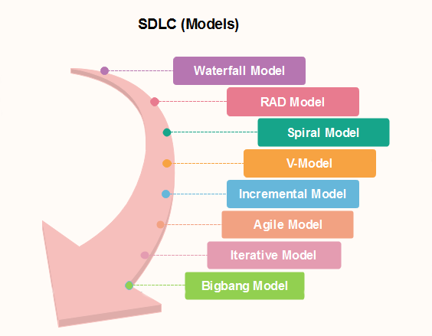
Popular SDLC models

Slide 15

Thanks to All

